Slide 1
21ECP302L- PROJECT Review -2 Context Aware Sign Language Translation Glove
Guide Name: Dr. Monika R
Designation: Assistant Professor
Project Coordinator: Dr . Bashyam.S
Designation: Assistant Professor
TEAM MEMBERS
VIJAY.R (RA2311004010071)
DASS.J (RA2311004010072)
HARISH.K (RA2311004010096)
III year,Department of ECE,SRM IST

Slide 2
INTRODUCTION
Assistive communication gloves translate sign language gestures into speech using flex and IMU sensors, but most systems lack emotion awareness and contextual intelligence.
Individual with hearing, speech, and mobility impairments face communication challenges in daily and emergency situations. An intelligent, emotion-aware system can improve clarity, independence, and safety.
The proposed embedded glove integrates IMU-based gesture dynamics, machine learning, context-based sentence prediction, and real-time voice feedback

Slide 3
MOTIVATION
Individual with hearing, speech, and mobility impairments often struggle to communicate effectively in real-time situations, especially in emergencies and healthcare environments. Existing assistive tools lack emotional understanding and contextual intelligence, limiting natural communication.
Most sign language gloves only convert gestures into individual words without emotion detection, sentence correction, or emergency recognition. They rely on basic threshold logic and do not integrate intelligent edge-based processing.
The proposed system enables emotion-aware communication, context-based sentence formation, and emergency alert capability using embedded AI. This improves communication clarity, user independence, and real-world applicability in assistive healthcare and daily interaction scenarios.

Slide 4
LITERATURE REVIEW
S.No | Journal Paper Title | Journal / Conference Details | Inference
1 | IMU-Based Sign Language Recognition Using Machine Learning | Zhang et al., IEEE Access, 2022, IEEE | Demonstrated gesture classification using IMU data and ML algorithms. Focused only on gesture recognition without emotion or contextual intelligence.
2 | Smart Glove for Sign Language Translation Using Flex Sensors | Kumar et al., International Journal of Engineering Research, 2021, Springer | Used flex sensors for gesture-to-word conversion. System lacked dynamic motion analysis and emotional inference.
3 | Wearable Gesture Recognition System for Assistive Communication | Lee et al., Sensors, 2023, MDPI | Proposed a wearable glove using motion sensors for sign translation. No integration of emotion detection or emergency functionality.
4 | Real-Time Sign Language Translation Using Embedded Systems | Ahmed et al., IEEE International Conference on IoT, 2020, IEEE | Implemented real-time embedded translation but limited to word-level mapping without contextual sentence formation.

Slide 5
S.No | Journal Paper Title | Journal / Conference Details | Inference
5 | Emotion Recognition Using Motion Sensor Data | Park et al., IEEE Sensors Journal, 2020, IEEE | Explored emotion detection through acceleration and motion patterns. Did not apply to assistive gloves or sign language systems.
6 | Edge AI for Wearable Health Monitoring Systems | Silva et al., ACM Transactions on Embedded Computing Systems, 2024, ACM | Demonstrated on-device ML processing for wearable devices. Supports feasibility of edge-based emotion classification in proposed project.
7 | Context-Aware Natural Language Processing for Assistive Devices | Rao et al., IEEE Transactions on Affective Computing, 2021, IEEE | Proposed NLP-based contextual sentence correction but not integrated with gesture-based systems.
8 | Deep Learning-Based Dynamic Sign Language Recognition Using Sensor-Embedded Smart Gloves | H. Zhou, Q. Wu, and T. Li, IEEE Internet of Things Journal, 2024. | The study demonstrates that combining flex sensors and IMU with a CNN-LSTM model significantly improves dynamic sign language recognition accuracy in real-time edge environments.

Slide 6
S.No | Journal Paper Title | Journal / Conference Details | Inference
9 | Machine Learning-Based Sign Language Recognition Using Sensor Fusion | Patel et al., Procedia Computer Science, 2022, Elsevier | Used sensor fusion for improved gesture accuracy. Did not incorporate emotional intensity estimation.
10 | Wearable Assistive Technology for Deaf and Mute Communication | Gomez et al., Springer Journal of Healthcare Engineering, 2022, Springer | Provided assistive communication solution but lacked emotion dynamics and contextual intelligence.

Slide 7
PROBLEM STATEMENT
Individual with hearing, speech, and mobility impairments rely on sign language, but existing assistive gloves translate only isolated gestures without contextual understanding. Current systems mainly use flex sensors with basic threshold logic, lacking intelligent processing capabilities. They do not support contextual sentence formation, advanced gesture analysis, or real-time edge-based intelligence. This project aims to develop a smart sign language translation glove using embedded edge processing for accurate, context-aware, real-time communication.

Slide 8
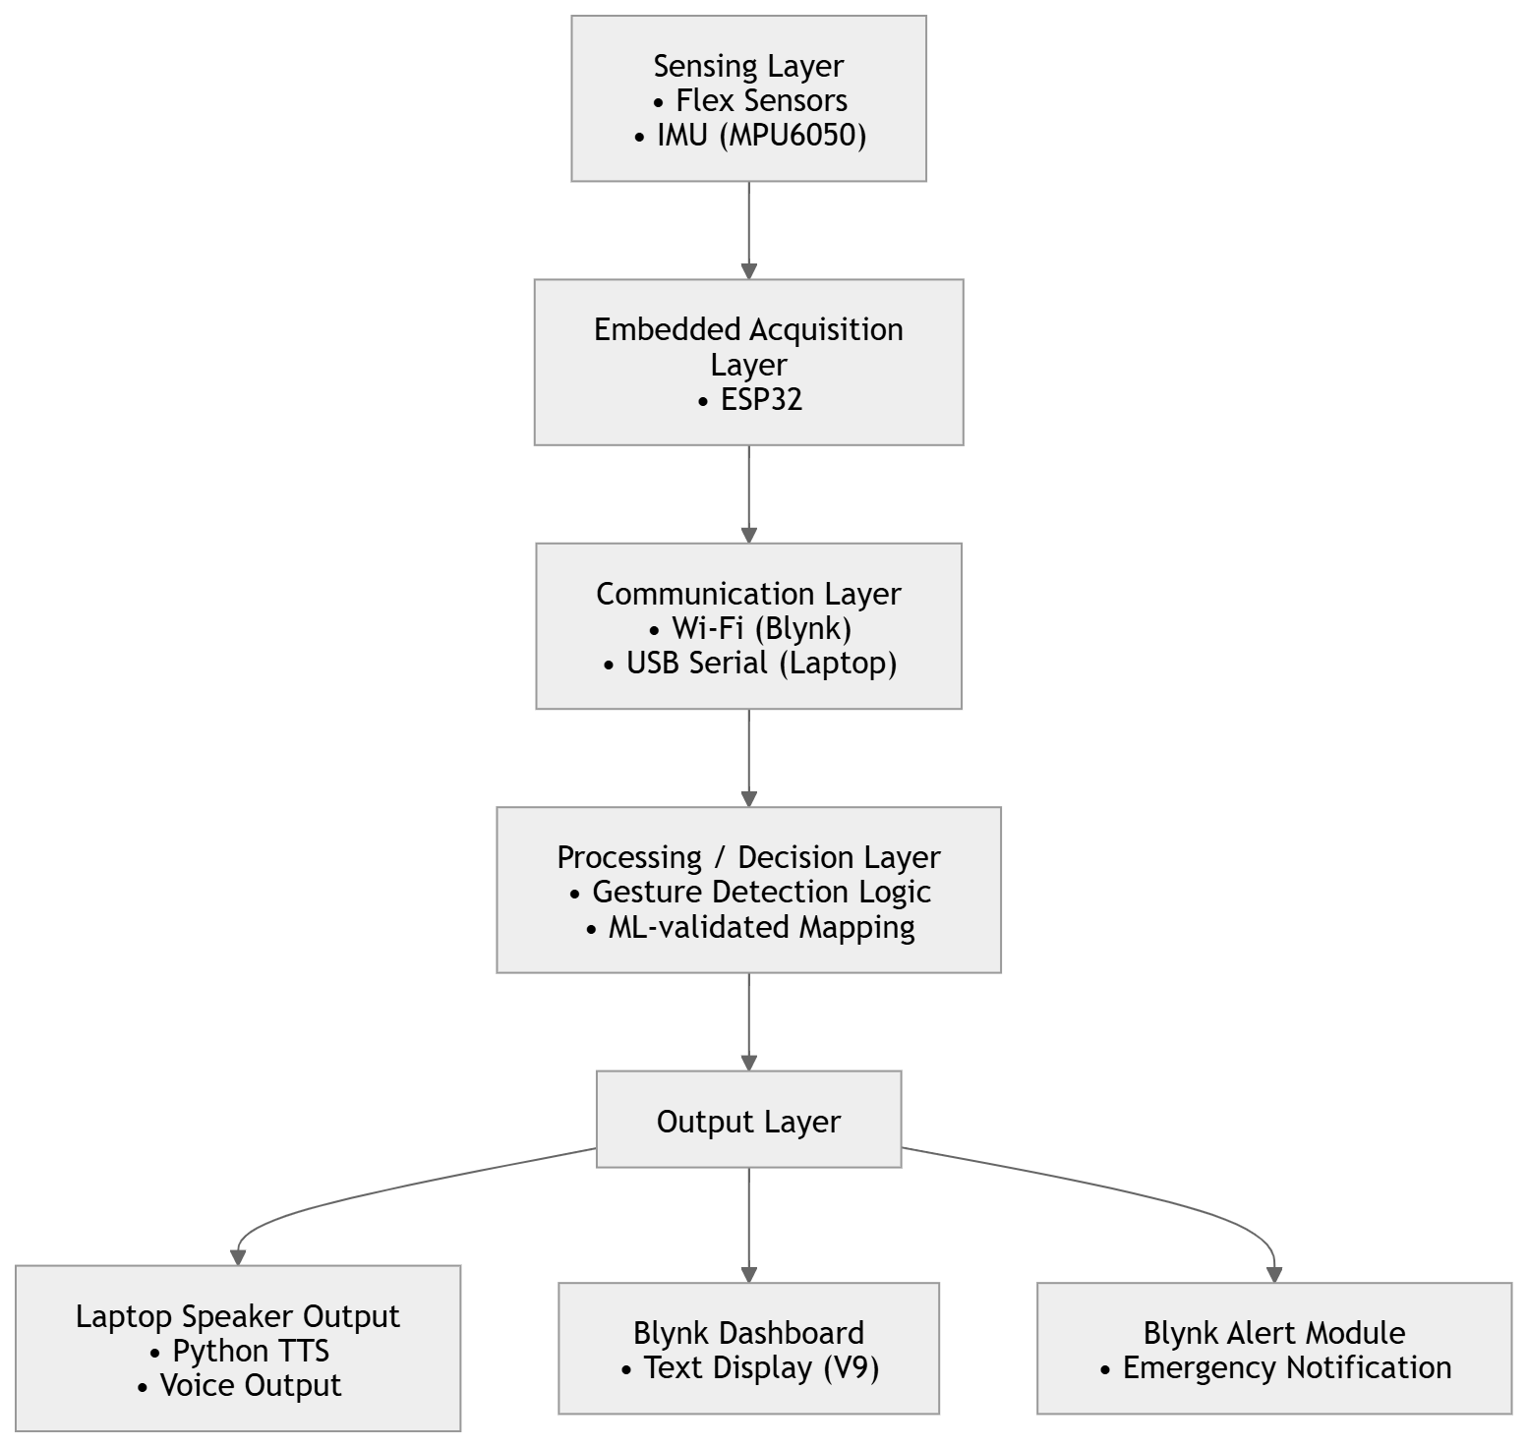
PROPOSED METHODOLOGY

Slide 9
PROBLEM DEFINITION & DESIGN ASPECTS
Problem Definition:
Design a wearable embedded system capable of translating sign gestures into speech with contextual awareness.
Design Aspects:
Sensor Fusion (Flex + IMU)
Voltage Divider for resistance measurement
ESP32 ADC
Wireless transmission architecture
Edge ML processing
Real-time output generation

Slide 10
WORKING PRINCIPLE
1️⃣ Gesture Acquisition
Flex sensors detect finger bending by measuring resistance variation.
The IMU (MPU6050) captures dynamic motion data including acceleration and angular velocity.
These sensors together capture both:
Static finger positions
Dynamic hand movement patterns
2️⃣ Embedded Data Processing (ESP32)
The ESP32 performs:
Signal conditioning
Analog-to-digital conversion
Noise filtering
Packet formation
The processed sensor data is then transmitted wirelessly via WiFi/Bluetooth to the Raspberry Pi.

Slide 11
3️⃣ MACHINE LEARNING CLASSIFICATION
Gesture recognition model identifies the performed sign
ML classifier processes temporal features for improved accuracy
C. Context & Decision Engine
Context-based sentence refinement
Emergency gesture pattern detection
Final decision fusion
4️⃣ Output Generation
Based on classification results:
Speaker provides voice output
Display shows text output
Alert module triggers emergency notification

Slide 12
IMPLEMENTATION PROGRESS
Dataset Creation
Sensor data collected using flex sensors and IMU (MPU6050)
Features include:
Flex sensor values (F1, F2, F3)
Accelerometer (AX, AY, AZ)
Gyroscope (GX, GY, GZ)
Each gesture recorded multiple times
Dataset is balanced for all classes
Stored in CSV format for ML training

Slide 13
IMPLEMENTATION PROGRESS
Machine Learning Model & Prediction Results
Algorithm used: Random Forest Classifier
Supervised learning approach
Input: Sensor values (Flex + IMU data)
Output: Gesture command label
Dataset split into training and testing sets
Model trained on labeled gesture dataset
Provides accurate and reliable classification
Example Prediction:
Input: [760, 820, 780, 600, 3200, 16000, 10, 20, -5] Output: MEDICINE

Slide 14
IMPLEMENTATION PROGRESS
Blynk IoT Application
Real-time patient message display
Communication via WiFi using ESP32
Emergency alerts sent as push notifications
Caretaker can monitor patient remotely
Simple and user-friendly interface

Slide 15
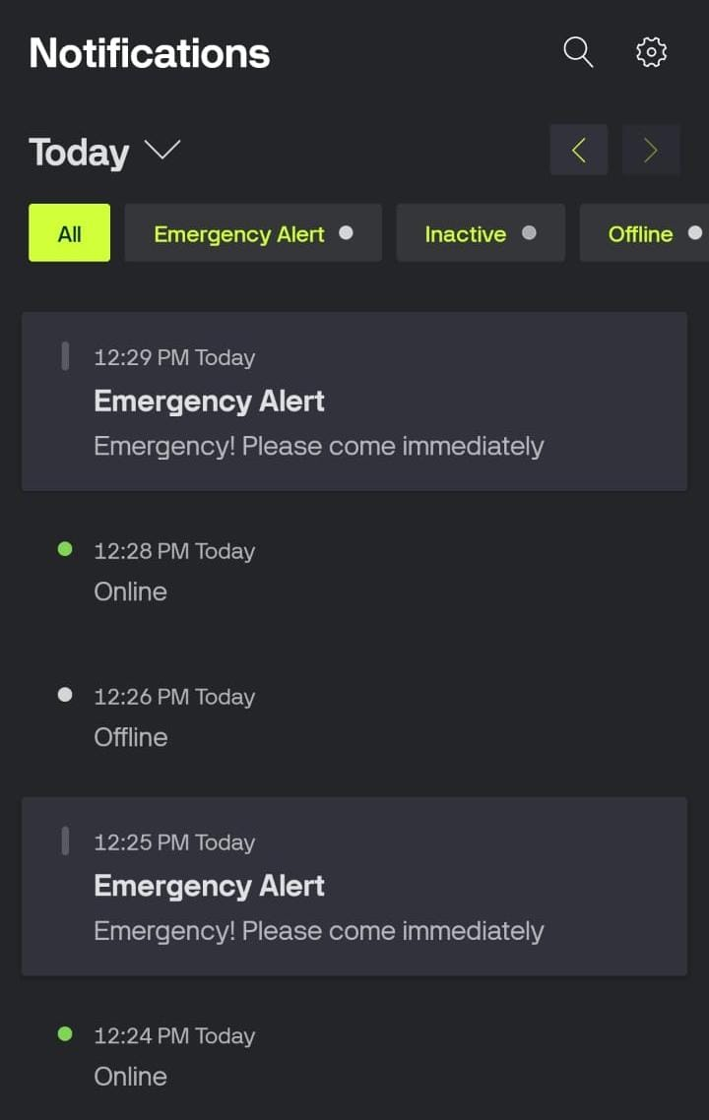
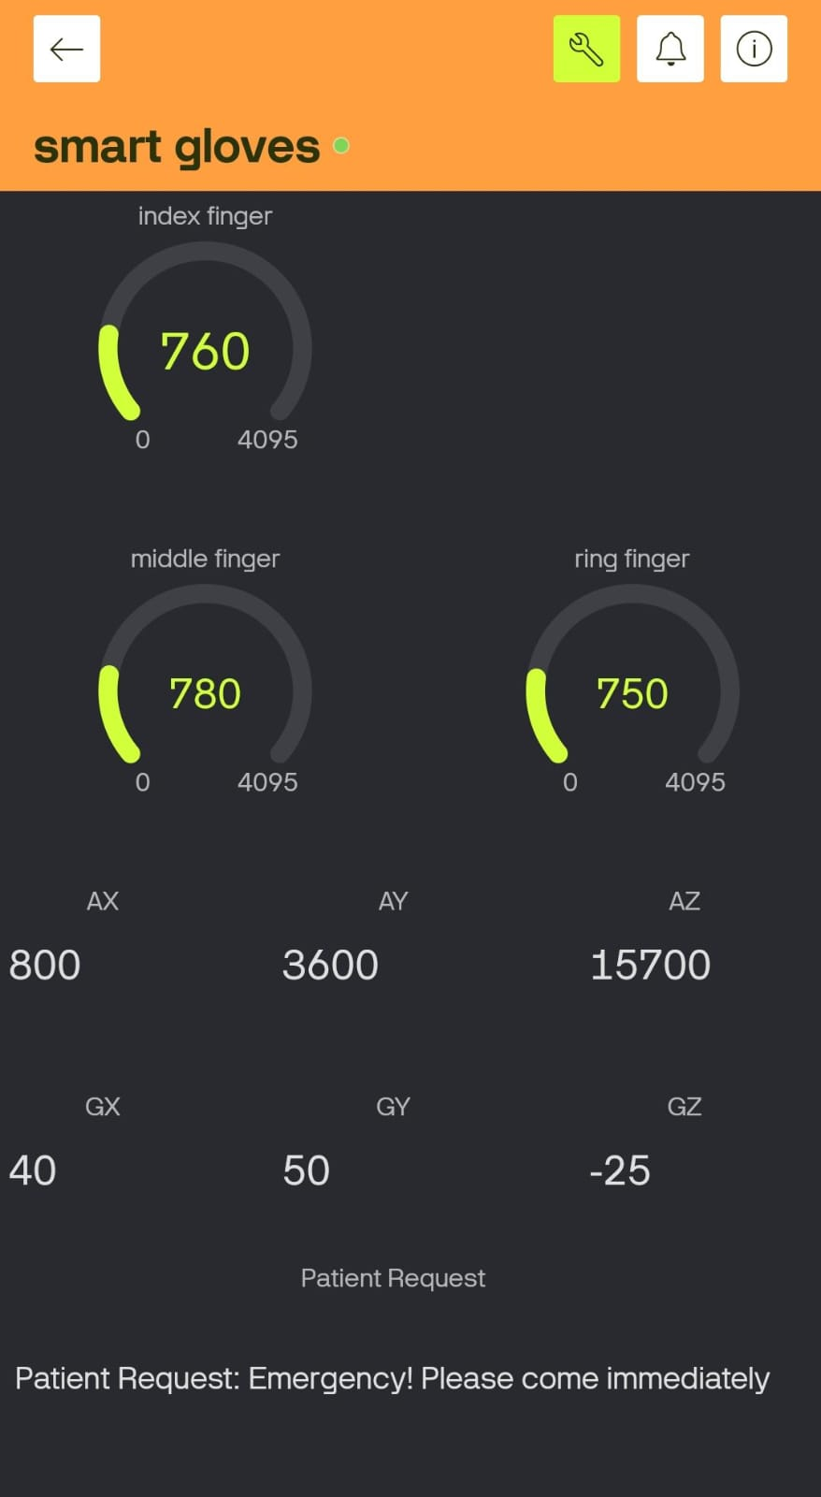
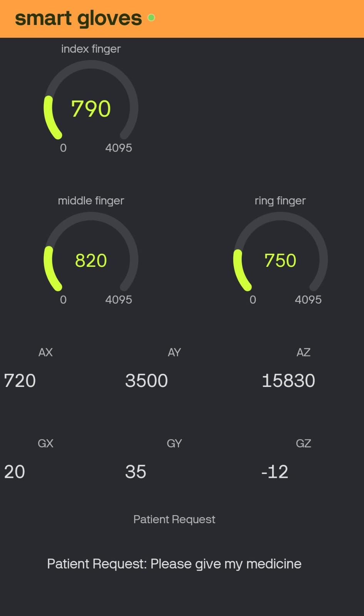
Outcome

Slide 16
CHALLENGES FACED
Difficulty in accurate sensor calibration
Variations in flex sensor readings for same gesture
Noise and instability in IMU (MPU6050) data
Hardware connection and wiring issues
Real-time data synchronization between sensors and ESP32
Integration of ML model with embedded system
Blynk app configuration and communication delays
Limited processing capability for real-time ML on ESP32

Slide 17
REFERENCES
[1] J. Zhang, L. Wang, and H. Li, “IMU-Based Sign Language Recognition Using Machine Learning Techniques,” IEEE Access, vol. 10, pp. 45678–45689, 2022.
[2] R. Kumar and S. Mehta, “Smart Glove for Sign Language Translation Using Flex Sensors,” Journal of Engineering Research, vol. 15, no. 3, pp. 210–218, 2021.
[3] Y. Lee, M. Park, and K. Kim, “Wearable Gesture Recognition System for Assistive Communication,” Sensors, vol. 23, no. 4, pp. 1456–1472, 2023.
[4] M. Ahmed, T. Hassan, and A. Rahman, “Real-Time Sign Language Translation Using Embedded Systems,” in Proc. IEEE Int. Conf. Internet of Things (IoT), 2020, pp. 233–238.
[5] S. Park and J. Kim, “Emotion Recognition Using Motion Sensor Data,” IEEE Sensors Journal, vol. 20, no. 14, pp. 8123–8132, 2020.
[6] D. Silva, P. Rocha, and F. Gomes, “Edge AI for Wearable Health Monitoring Systems,” ACM Transactions on Embedded Computing Systems, vol. 23, no. 2, pp. 1–18, 2024.
[7] V. Rao and R. Iyer, “Context-Aware Natural Language Processing for Assistive Devices,” IEEE Transactions on Affective Computing, vol. 12, no. 3, pp. 567–578, 2021.
[8] X. Chen, Y. Liu, and Z. Zhao, “Gesture-Based Emergency Detection in Wearable Systems,” IEEE Internet of Things Journal, vol. 10, no. 5, pp. 3890–3899, 2023.
[9] A. Patel and M. Shah, “Machine Learning-Based Sign Language Recognition Using Sensor Fusion,” Procedia Computer Science, vol. 200, pp. 145–152, 2022.
[10] L. Gomez and R. Torres, “Wearable Assistive Technology for Deaf and Mute Communication,” Journal of Healthcare Engineering, vol. 2022, Article ID 9876543, 2022.

